Slide 1
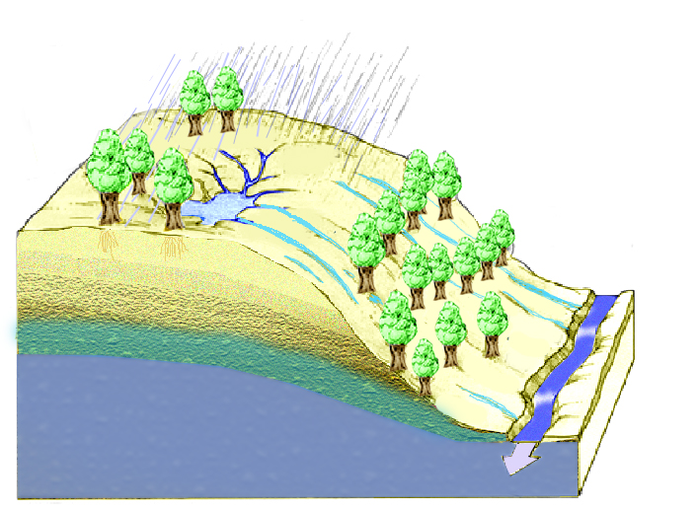
What physical factors affect runoff terms in the water balance?
Climate
Topography
Soils
Vegetation
Land-use

Slide 2
Climate Factors
Precipitation
Seasonal Cycle
Intermittency
Form (Rain or Snow)
Potential Evaporation
Temperature

Slide 3
Topography
Slope
Aspect (Solar Radiation, Potential Evaporation)
Convergence
Saturation and wetness index

Slide 4
Topographic definition of contributing area, concentrated at a point or dispersed (specific catchment area) on a hillslope.

Slide 5
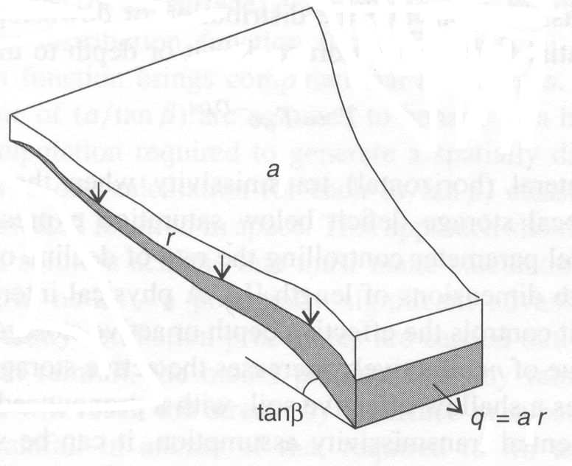
Convergence Quantified Using Topographic Wetness Index
Upslope area draining through a point within a catchment
S
q = a r
q_{cap} = T S
Saturation occurs when

Slide 6
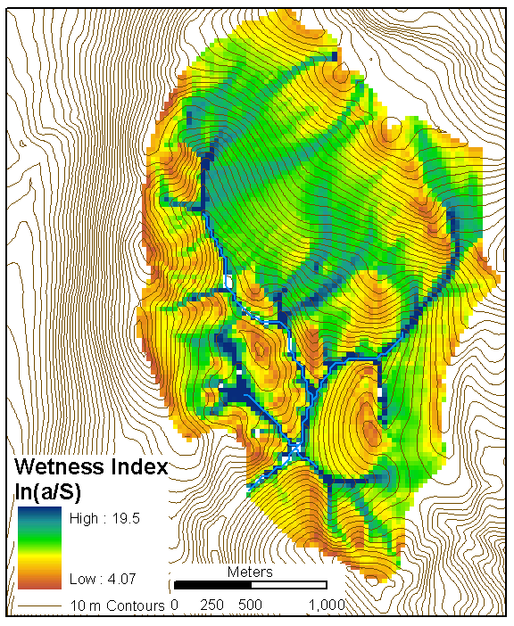
ln(a/S) wetness index for a small watershed evaluated from a 30 m Digital Elevation Model.

Slide 7
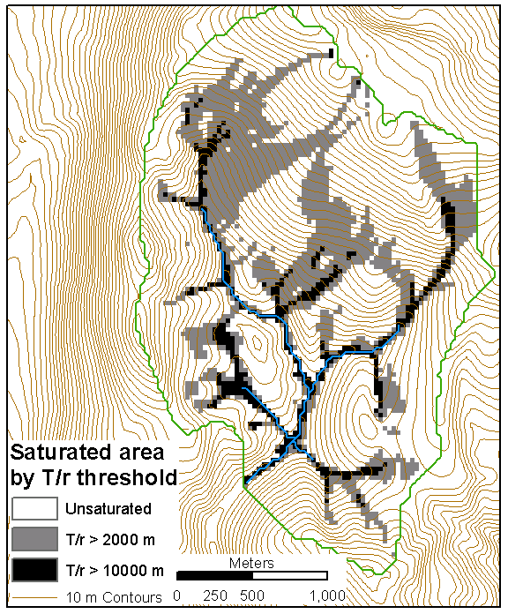
Saturated area based on wetness index for two different T/r thresholds.

Slide 8
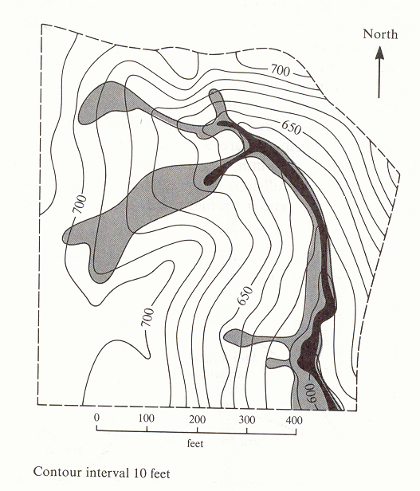
Map of saturated areas showing expansion during a single rainstorm. The solid black shows the saturated area at the beginning of the rain; the lightly shaded area is saturated by the end of the storm and is the area over which the water table had risen to the ground surface. (from Dunne and Leopold, 1978)

Slide 9
Soils
Infiltration capacity K_{sat}
Drainable porosity (saturated water content - water content at field capacity) x Depth
Field capacity (Water remaining after gravity drainage) x Depth
Erodability

Slide 10
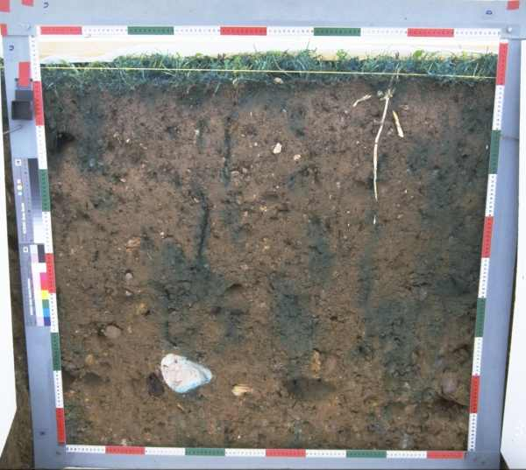
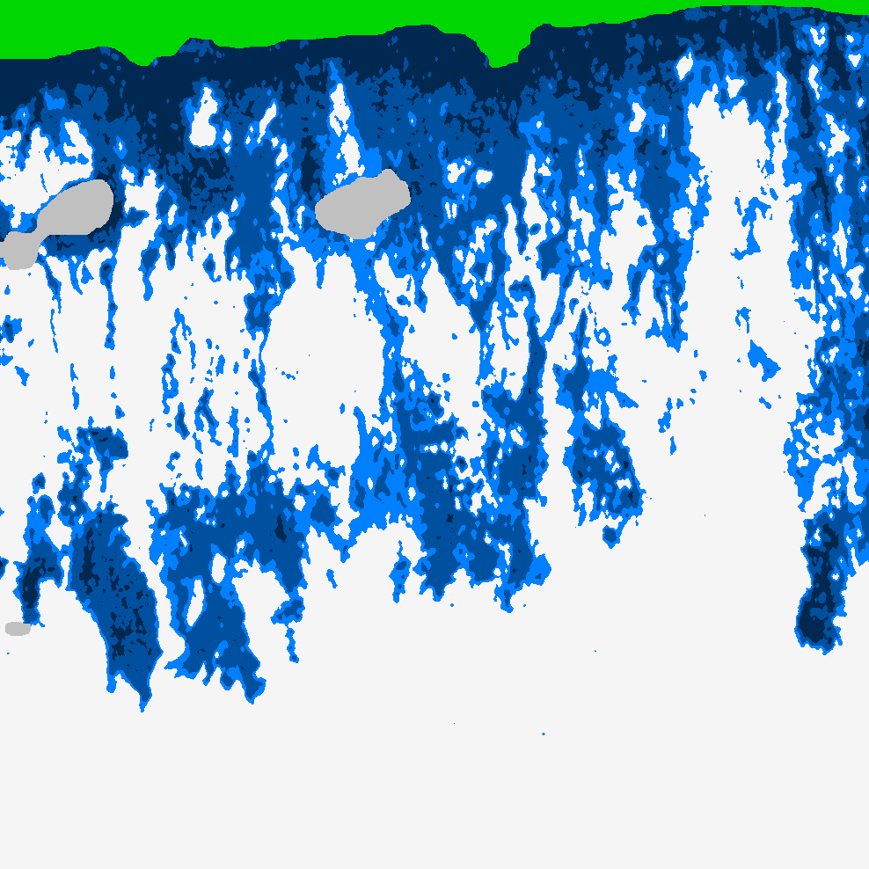
Infiltration follows preferential pathways
(a) Photograph of cross section through soil following dye tracing experiment. (b) Moisture content inferred from dye tracing experiment. (Courtesy of Markus Weiler)

Slide 11
Vegetation
Density (leaf area index)
Affects interception
Canopy conductance (relates ET to atmosphere vapor pressure deficit)
Root depth, strength and density (inhibit erosion and landslides)
Drives soil formation and responsible for preferential pathways

Slide 12
Land use
Agriculture
Irrigation withdrawals
Erodibility
Infiltration capacity
Pollution (Manure, E. Coli, fertilizers, …)
Urbanization
Impervious areas
Water withdrawals
Stormwater drains / soak pits
Pollution
Wastewater discharge
Street runoff

Slide 13
How do runoff processes depend on Climate, Vegetation, Land use, Topography and Soils?
Direct precipitation and return flow dominate hydrograph; subsurface stormflow less important
Thin soils; gentle concave footslopes; wide valley bottoms; soils of high to low permeability
Horton overland flow dominates hydrograph; contributions from subsurface stormflow are less important
Variable source concept
Subsurface stormflow dominates hydrograph volumetrically; peaks produced by return flow and direct precipitation
Topography and soils
Steep, straight hillslopes; deep,very permeable soils; narrow valley bottoms
Arid to sub-humid climate; thin vegetation or disturbed by humans
Humid climate; dense vegetation
Climate, vegetation and land use
(From Dunne and Leopold, 1978)

Slide 14
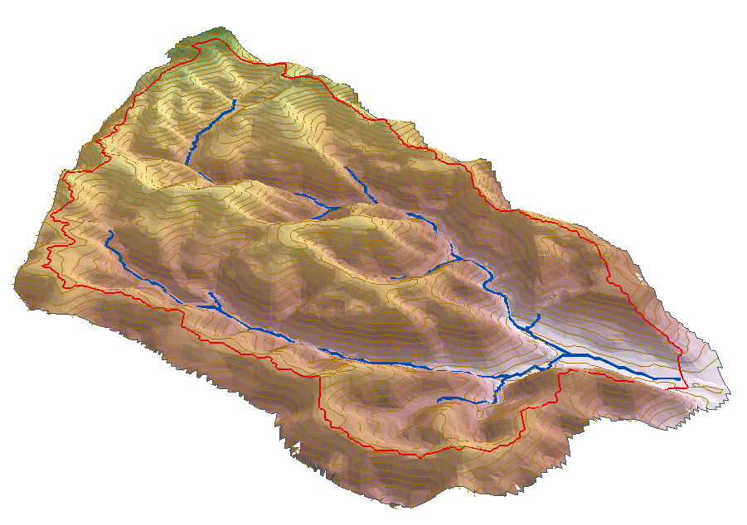
Short time scale water balance
P
ET
Retention fraction
Retention
G_{in}
Q
S
G_{out}

Slide 15
SCS Curve Numbers to Quantify Retention
CN=100
90
80
70
60
50
40
30
20

Slide 16
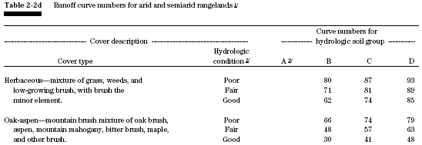

Slide 17
Long Time Scale Water Balance
P
∆S=P-Q-E
E
P=Q+E
Q=P-E
∆S
Q

Slide 18
P=Q+E
E=P
E
Q
E=Ep
E
P

Slide 19
P=Q+E
E=P
E
Q
E=Ep
W=Q/P 1
E
P
W=Q/P 0

Slide 20
Long Time Scale Water Balance and Runoff
Q=P-E
Reducing Retention
Reducing Retention
Notes
P/Ep is an index of dryness
Reduced retention increases runoff
Imperviousness increases runoff
Variability in Q due to differences between large numbers, P-E
Greater relative sensitivity in arid areas

Slide 21
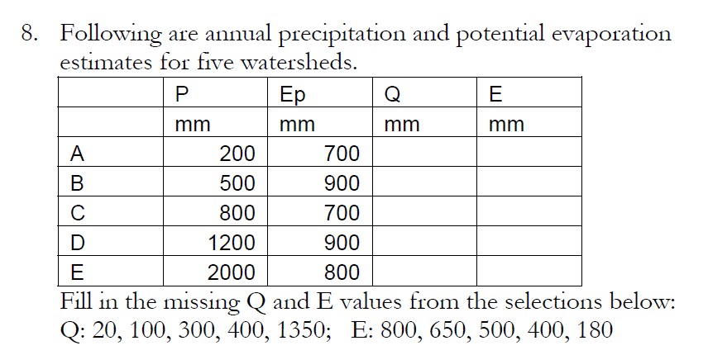

Slide 22
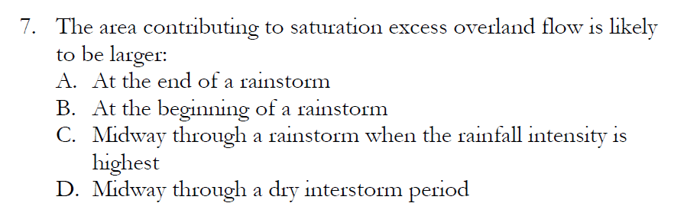
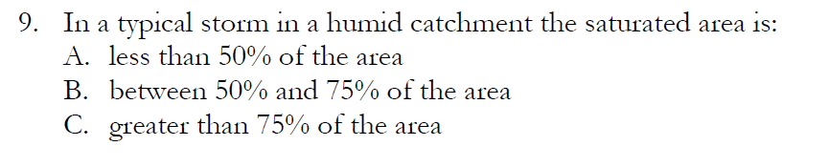

Slide 23
Generalised dependence
of Runoff Coefficient
and Style of Overland Flow on Arid-Humid scale and on Storm Rainfall Intensities
Seasonal or storm period fluctuations
(Slide courtesy of Mike Kirkby, University of Leeds, presented at AGU Chapman Conference on Hillslope Hydrology, 2001)

Slide 24
What can we learn from considering seasonality in the long time scale water balance?
P
Q/Ep
Ep
Ep
Low Retention
P
High Retention
P/Ep
Low Retention
Q=f(P,Ep,S)
High Retention
Low Retention
High Retention

Slide 25
Summer (in phase) seasonal precipitation
P
Q/Ep
Ep
Low Retention
Ep
High Retention
P
P/Ep
Low Retention
Q=f(P,Ep,S)
Low Retention
High Retention
High Retention

Slide 26
Winter (off phase) seasonal precipitation
P
Q/Ep
Ep
Low Retention
Ep
High Retention
P
P/Ep
Low Retention
Q=f(P,Ep,S)
Low Retention
High Retention
High Retention

Slide 27
Summary
Retention reduces runoff
Retention accentuates interaction with Ep
Arid climates (P < Ep) have greater relative sensitivity

Slide 28
Other Considerations
Snow and snow storage
Spatial variability (elevation, temperature, orographic precipitation)
Quick flow versus base flow

Slide 29
For a watershed you need to know
Upstream water management
Reservoirs and diversions
Land-use and how it may change
Vegetation
Soils
Impervious areas
Saturated areas (topography)

Slide 30
Geographic attributes you need to know
The watershed (area)
The stream network
Slope
Distance to stream

Slide 31
100
Reynolds Ck, ID
Coshocton, OH
10
ID
Mean annual Runoff (inches)
IA
PA
OH
Reisel, TX
MO
VA
1
San Pedro, AZ
AZ
OK
TX
MS
GA
Walnut Gulch, AZ
FL
0.1
0.001
0.1
10
1000
Area (sq. miles)
Scale dependence of mean annual runoff for different geographic locations in the U.S. (Courtesy of David Goodrich, USDA-ARS).

Slide 32
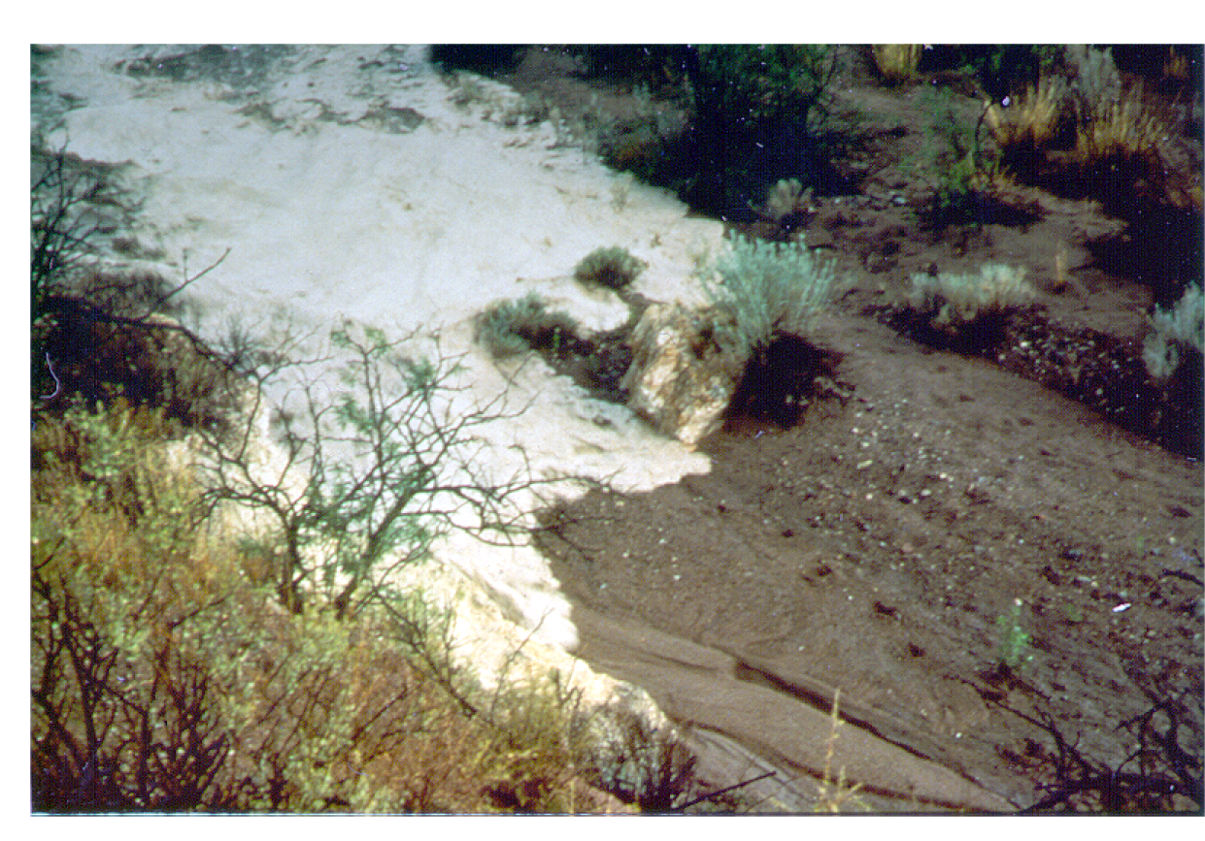
Flood wave advancing over a dry stream bed in Walnut Gulch experimental watershed where channel transmission losses are considerable. (Courtesy of David Goodrich, USDA-ARS)

